Slide 1
RolloverCounter - class diagram
LimitedCounter
RolloverCounter
package counters
RolloverCounter
maxToCount
RolloverCounter
minToCount
RolloverCounter
maxToCount
count
unCount
The count() and unCount() methods override the BasicCounter
count() and unCount() methods. (This means that they replace them -
so a Rollover instance counts and unCounts this way, but a Basic
instance still counts and unCounts the original way.

Slide 2
RolloverCounter - header & constructors
LimitedCounter
RolloverCounter
package counters
RolloverCounter
maxToCount
RolloverCounter
minToCount
RolloverCounter
maxToCount
0008 package counters;
0009
0010 public class RollOverCounter extends LimitedCounter {
0011
0012 public RollOverCounter() {
0013 super();
0014 } // End default Constructor.
0015
0016 public RollOverCounter( int maxToCount) {
0017 super(maxToCount);
0018 } // End alternative Constructor.
0019
0020 public RollOverCounter( int minToCount, int maxToCount) {
0021 super( minToCount, maxToCount);
0022 } // End principal Constructor.

Slide 3
RolloverCounter - count()
count
o
c1
o
else
reset to minimum
safe to count
minimum
BasicCounter
Set Count To
BasicCounter
count
c1: If counter at maximum.
0025 public void count(){
0026 if ( this.isAtMaximum()) {
0027 this.setCountTo( this.minimumIs());
0028 } else {
0029 super.count();
0030 } // End if.
0031 } // End count.

Slide 4
RolloverCounter - unCount()
0033 public void unCount(){
0034 if ( this.isAtMinimum()) {
0035 this.setCountTo( this.maximumIs());
0036 } else {
0037 super.unCount();
0038 } // End if.
0039 } // End unCount.

Slide 5
RolloverCounterDemo
0009 package counters;
0010
0011 public class RollOverDemonstration {
0012
0013 public static void main( String argv[]) {
0014
0015 RollOverCounter demoCounter = new RollOverCounter( 10, 12);
0016
0017 System.out.println( "\n\t\t Roll Over Counter demonstration \n");
Roll Over Counter demonstration

Slide 6
RolloverCounterDemo - count to limit
0023 System.out.println( "\n Demonstrating numberCountedIs()");
0024 System.out.print( "The value should be 10 ... ");
0025 System.out.print( demoCounter.numberCountedIs());
0026 System.out.println( "." );
0027
0028 System.out.println( "\n Counting two occurrences with count()");
0029 demoCounter.count();
0030 demoCounter.count();
0031 System.out.print( "Its value should now be 12 ... ");
0032 System.out.print( demoCounter.numberCountedIs());
0033 System.out.println( "." );
The counter has been created with a
range of 10 to 12 and an initial value of 10.
Demonstrating numberCountedIs()
The value should be 10 ... 10.
Counting two occurrences with count()
Its value should now be 12 ... 12.

Slide 7
RolloverCounterDemo - count below/beyond
0035 System.out.println( "\nCounting another occurrence with count()");
0036 demoCounter.count();
0037 System.out.print( "Its value should now be 10 ... ");
0038 System.out.print( demoCounter.numberCountedIs());
0039 System.out.println( "." );
0040
0041 System.out.println( "\n Uncounting an occurrence with unCount()");
0042 demoCounter.unCount();
0043 System.out.print( "Its value should now be 12 ... ");
0044 System.out.print( demoCounter.numberCountedIs());
0045 System.out.println( "." );
0046 } // End main.
0047
0048 } // End RollOverDemonstration.
Counting another occurrence with count()
Its value should now be 10 ... 10.
Uncounting another occurrence with unCount()
Its value should now be 12 ... 12.

Slide 8
WarningCounter - class diagram
BasicCounter
WarningCounter
package Counters
WarningCounter
minToCount
WarningCounter
minToCount
WarningCounter
maxToCount
!
count
!
unCount
The exclamation mark in the count() and unCount() boxes indicate that it might throw an exception. (The exception will be thrown if an attempt is made to count above the maximum or below the minimum.)

Slide 9
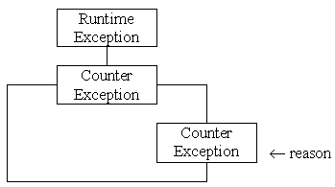
CounterException
0008 package Counters;
0009
0010 class CounterException extends RuntimeException {
0011
0012 public CounterException( String reason) {
0013 super( reason);
0014 } // End CounterException constructor.
0015
0016 } // End CounterException
When the exception is throw the reason given to the constructor will be shown (unless the exception is caught and handled first.)

Slide 10
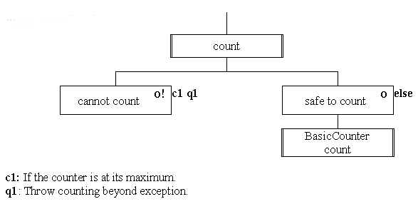
WarningCounter - count() method
0021 public void count() {
0022 if ( this.isAtMaximum()) {
0023 throw new CounterException( "Attempt to count beyond limit.");
0024 } else {
0025 super.count();
0026 } // End if.
0027 } // End count.

Slide 11
WarningCounterDemo - count beyond limit
0035 System.out.println( "\nCounting another occurrence with count()”);
0036 System.out.println( " This should throw an exception ... ");
0037 demoCounter.count();
0038 System.out.print( "This message should never appear!");
Counting another occurrence with count()
This should throw an exception ...
Counters.CounterException: Attempt to count beyond limit.
at Counters.WarningCounter.count(WarningCounter.java:27)
at WarningDemonstration.main(WarningDemonstration.java:31)

